Slide 1
S.A. Matasov
Forward
Main
PROSPECTS OF COLON CANCER SCREENING AND TREATMENT
Part 3. AMANUAL METHOD OF INTUBATIONAL COLONOSCOPY
"Level of serious complications from colonoscopy screening is 10 times higher than from others widely used cancer screening tests" [1]
1. Contents
Contents of slides.
Clinical estimation of manual colonoscopy.
Straightening-shortening of colon – requirement of manual colonoscopy.
Difficulties of manual intubation – the reason of colonoscopy trauma.
Difficulties of manual intubation – the reason of colonoscopy inaccessibility.
Search of alternative for manual colonoscopy.
Requirements to adequate colonoscopy.
L.Euler Q₁/Q₂=e^{αƒ} formula – theoretical framework of intestinal intubation.
The first two-forced colonoscope.
Illustration of the generation of pneumatic force.
Testings of the "Pull-&-Push" system.
Pneumo-mechanical colonoscope with disposable cartridge; illustration of work.
Conclusion.
14, 15. Main sources of information.
© Reference on www.coloncancer.lv is obligatory

Slide 2

Prospects of colon cancer screening and treatment
Part 3. Amanual method of intubational colonoscopy
Forward
Back
2. Clinical estimation of manual colonoscopy
Faith Ringgold “The American People.
The In Crowd.”
“There is no direct evidence to conclude that screening with colonoscopy reduces the risk of colorectal cancer mortality or colorectal cancer incidence. It is not also clear, whether is compensated the complexity, inconvenience and cost of colonoscopy procedure” [2]
"The presence of at least one of four colonoscopic factors from previous colonoscopy (incomplete colonoscopy, bad preparation of intestine, incomplete polyp's removal, lack of surveillance colonoscopy within 5 years) accounted for 41,1% of colorectal cancers, whereas presence of at least one of four polyp factors accounted for only 21,7%: size 1 cm and more, villous components or high-grade dysplasia, and the presence of at least 3 polyps or at least 1 proximal polyp" [3].
Possibility of full colonoscopy was adequately estimated on 20.085 colonoscopies, made by 2.681 endoscopists: "Unfortunately in the United Kingdom complete colonoscopic examination to caecum is achieved in only 70% of cases” [4].
This data suggests, that the culprits of incomplete colonoscopy are not endoscopists, but the authors of manual method.
© Reference on www.coloncancer.lv is obligatory

Slide 3
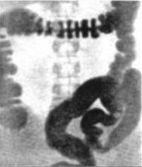
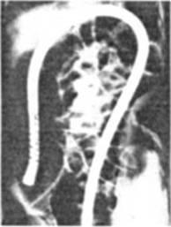
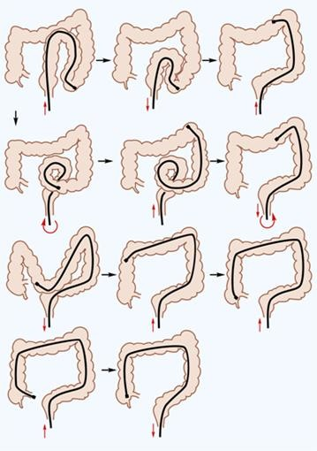
Prospects of colon cancer screening and treatment
Part 3. Amanual method of intubational colonoscopy
Forward
Back
3. Straightening-shortening of colon – requirement of manual colonoscopy
1,6-meter long endoscopic tube is introduced by doctor’s hands by straightening-shortening of colon; an endoscope, absorpted by sigmoid or transverse intestine, will never reach caecum. Difficulties of extra-intestinal 1-forced manual intubation - among the reasons of omission of 32.8% of polyps and 31.4% of adenomas [5].
Natural
colon configuration
Complete colonoscopy –
endoscope reached of caecum
Tricks of extraintestinal
straightening-shortening of colon
In order to reach the caecum the natural colon curves should be shortened by 3-4 times and its axis – by 2 times - till 70-80 cm. It is realized by reciprocating and rotary movements of endoscopic tube [6].
© Reference on www.coloncancer.lv is obligatory

Slide 4
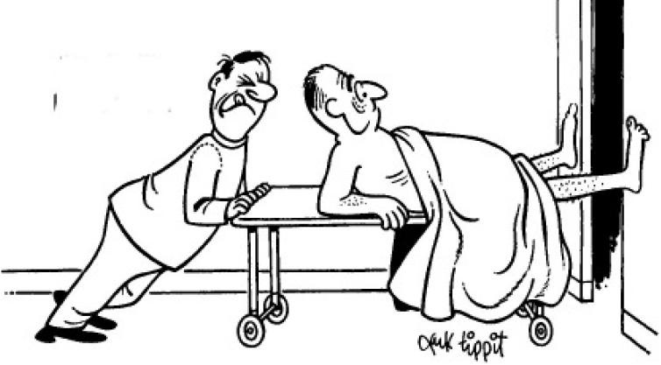
Prospects of colon cancer screening and treatment
Part 3. Amanual method of intubational colonoscopy
Forward
Back
4. Difficulties of manual intubation – the reason of colonoscopy trauma.
Straightening-shortening of colon necessarily stretches its wall and mesentery, generates an unbearable pain and microtraumas of mucosa, which threaten to cross-infection of patients. Bleeding and other serious complications do occur in 1 on 200 colonoscopies [7]; perforations during diagnostic examination reach 0.8% [8]. The fear of the colonoscopy lead to the abdication of it; in Germany CRC screening held annually only 3-4% of seniors [9].
© Reference on www.coloncancer.lv is obligatory

Slide 5
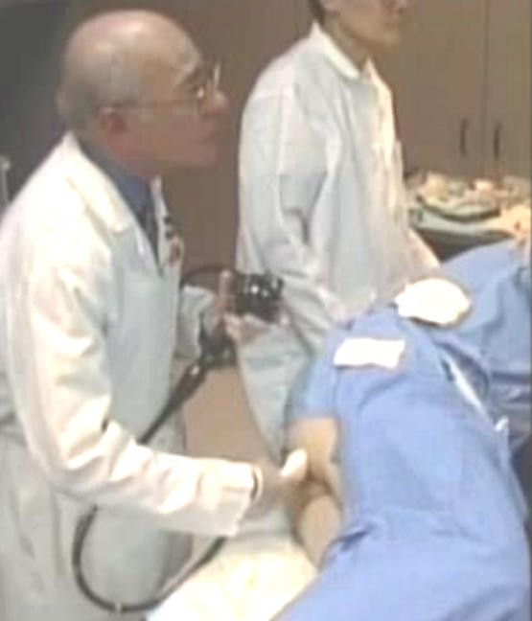
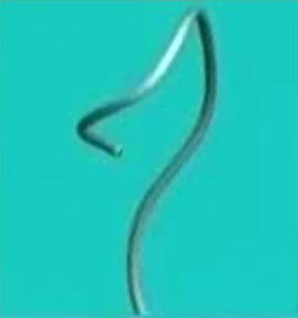
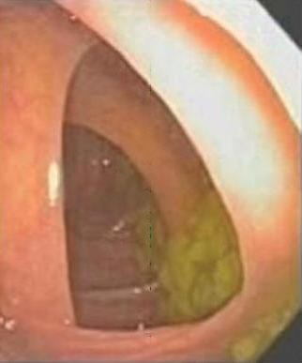
Prospects of colon cancer screening and treatment
Part 3. Amanual method of intubational colonoscopy
Forward
Back
5. Difficulties of manual intubation – the reason of colonoscopy inaccessibility
Colon straightening-shortening is mastered on patients; in 1st year caecum is reached in 56- 75% [10]. Here is interesting note: “Prof. told that after 5 thousands of colonoscopies I will steer
... as he does” [11]. However the art of colonoscopy which gives 90-98% full intubations
[12,13], requires 10 thousands hours of “self-training” [6] - about 20 thousands of procedures.
“Colonoscopy in sleep”, which is used today almost everywhere, somewhat facilitated straightening-shortening of colon, but by depriving patient of defence reaction, it increase in 2,6 times the number of perforations [14].
Readiness of doctor for manual colonoscopy is estimated by the records of: manipulations of pretender, magnetic control of endoscope’s configuration, overall picture of mucosa [15].
Fragment of colonoscopy
Fragment of magnetic control
Fragment of mucosa record
© Reference on www.coloncancer.lv is obligatory

Slide 6
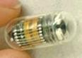
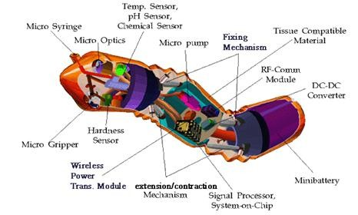
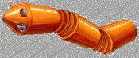
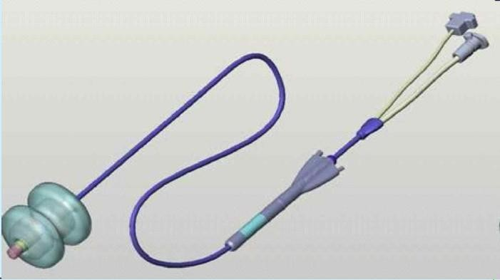
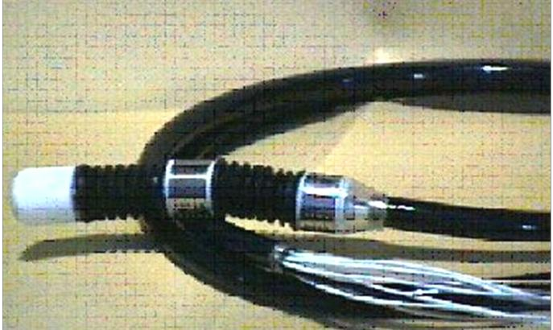
Prospects of colon cancer screening and treatment
Part 3. Amanual method of intubational colonoscopy
Forward
Back
6. Search of alternative for manual colonoscopy
For findings of new means for examination of large bowel [16] were spent hundreds of millions dollars, but there is no result: autonomous devices, for example, endoscopic capsule – are out of control, the tubular ones - does not guarantee complete intubation or, as manual colonoscopy, require individual intubation skill.
Endoscopic capsule
Project of robot-endoscope, S. Korea
Walking Aer-O-Scope, Israel
“Robot-locomotive”, Italy
© Reference on www.coloncancer.lv is obligatory

Slide 7

Prospects of colon cancer screening and treatment
Part 3. Amanual method of intubational colonoscopy
Forward
Back
7. Requirements to adequate colonoscopy
Adequate colonoscopy must be:
Ergonomic, i.e. to ensure convenient colon intubation.
Atraumatic, i.e. intubation must not
damage colon.
Painless, i.e. should not require
anesthesia.
Complete, i.e. must ensure intubation
till caecum.
Proportional, i.e. intubated colon part
must correspond to the length of
colonoscope.
New colonoscopy also should:
Provide biopsy and a number of other endoscopy operations.
Exclude cross-infection of patients (see Part 1, Aseptic method of flexible endoscopy).
© Reference on www.coloncancer.lv is obligatory

Slide 8
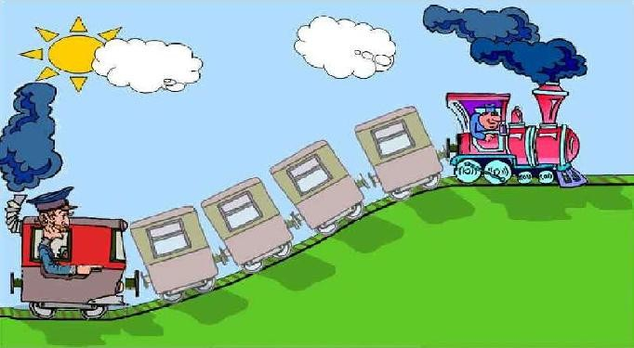
Prospects of colon cancer screening and treatment
Part 3. Amanual method of intubational colonoscopy
Forward
Back
8. L.Euler Q₁/Q₂=e^{αƒ} formula – theoretical framework of intestinal intubation
L.Euler formula Q₁/Q₂=e^{αƒ} confirmed an empirical finding, that the reason for the difficulties of intestines intubation is its bends. In formula it is value α – the sum of large intestine’s bends reaches 1000°; for complete manual colon intubation this angle should be reduced till 180°. The final output of the analysis of Euler formula – our proposal of intubation according the "push-&-pull" principle.
© Reference on www.coloncancer.lv is obligatory

Slide 9
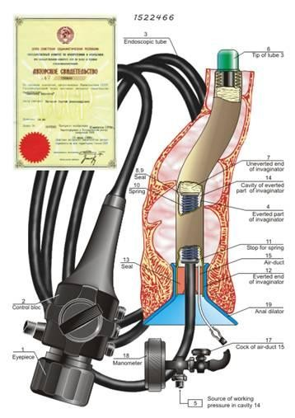
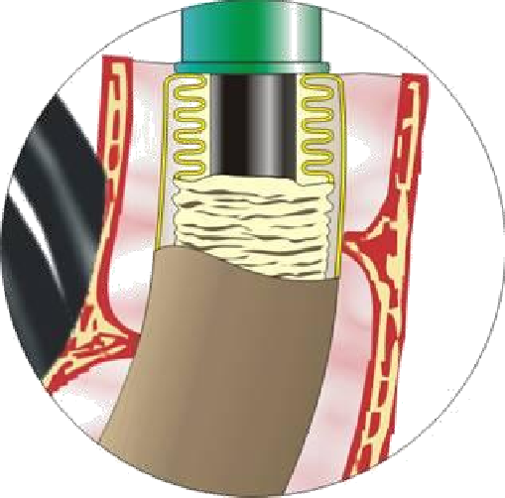

Prospects of colon cancer screening and treatment
Part 3. Amanual method of intubational colonoscopy
Forward
Back
9. The first two-forced colonoscope
The first "push-&-pull" colonoscope was applied in 1978 – see on the web-site of the European Patent Office [17].
Non-everted part of Invaginator, gathered on
the end of endoscope
Everted part of invaginator
Intraintestinal force "pull" is generated by invaginator – thin-walled sleeve everted by air pressure as a finger of surgeon’s glove (see slide 10); the synchronous external force "push" – by an endoscopist hand. The nature of intubational forces allows to call the first two-forced colonoscope as the pneumo-manual one.
© Reference on www.coloncancer.lv is obligatory

Slide 10
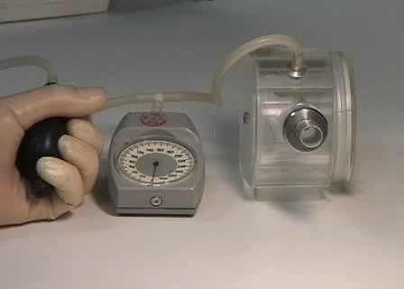
Prospects of colon cancer screening and treatment
Part 3. Amanual method of intubational colonoscopy
Forward
Back
10. Illustration of the generation of pneumatic force
The rolling of an everted invaginator on the colon mucosa provides atraumaticity of pneumo-manual intubation.
To view the video click on this photo
© Reference on www.coloncancer.lv is obligatory

Slide 11
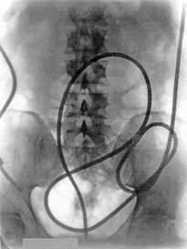
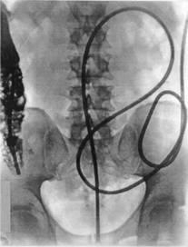
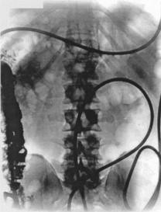
Prospects of colon cancer screening and treatment
Part 3. Amanual method of intubational colonoscopy
Forward
Back
11. Testings of the "Pull-&-Push" system
Testings results have clearly proved: 1) ergonomics of intubation – it was realised by engineer; 2) possibility of proportionate and complete intubation of large intestine – see roentgenogramms; 3) painlessness of intubation – volunteers does not feel nor the beginning, neither the progress or finishing of intubation.
Roentgenogramms, fixing the first testing of two-forced intubation system. On the left – the complete intubation of large intestine, in the center and on the left – the same plus selective contrasting of caecum and ascending colon. Tester – Y.M.A., test subject – S.A.M.
© Reference on www.coloncancer.lv is obligatory

Slide 12
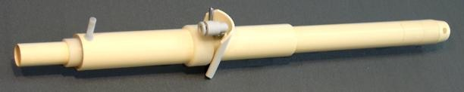


Prospects of colon cancer screening and treatment
Part 3. Amanual method of intubational colonoscopy
Forward
Back
12. Pneumo-mechanical colonoscope with disposable cartridge; illustration of work
Disposable cartridge
Rectal part of cartridge, Comprising invaginator
Feeder
Anal stopper
The second two-forced colonoscope [18] comprises the disposable cartridge, which is putted on the distal end of the insertion part of endoscopic tube.
The cartridge comprises invaginator and feeder. The feeder replaced an arm of endoscopist thus excluded the subjective moment of intubation. In this connection there are grounds to name the second two-forced endoscope as self-propelled.
The pneumo-mechanical intubation looks like the snake movement (see video). The process of intubation is controlled by the pedal of the feeder and by the guided distal end of colonoscope.
To view the
video click on this photo
© Reference on www.coloncancer.lv is obligatory
12

Slide 13
Prospects of colon cancer screening and treatment
Part 3. Amanual method of intubational colonoscopy
Forward
Back
13. Conclusion
The results of the work of 2.681 endoscopists who managed to reach the caecum only in 70% of cases, proved that not they are culprits of incomplete examinations, but the authors of the manual method of intubational colonoscopy and corresponding endoscopes. Bleeding and other serious complications that occur in 1 case out of 200 colonoscopies, colon perforations reaching 0.8%, the need for general anesthesia are also among complaints to authors of the manual method.
Alternative colonoscopy should be ergonomic, atraumatic, painless, complete and proportionate, provide a biopsy and exclude cross-infection of patients.
L. Euler's formula Q₁/Q₂=e^{αƒ} confirmed the empirical conclusion that the reason for the large intestine’s intubation difficulties lies in its bends, the sum of which reaches 1000^{О}; and allowed to offer intubation according the "pull-&-push principle "
The first "pull-&-push" colonoscope was applied by the author back in 1978. Its intraintestinal force "pull" is generated by an invaginator - a thin-walled sleeve everted by air pressure as a finger of a surgical glove; source of synchronous external force "push" is the hand of the endoscopist.
Testings of the two-forced colonoscope in humans have proved: 1. ergonomic intubation, 2. complete and proportionate intubation, 3 painless intubation.
The second two-forced colonoscope comprises a disposable cartridge, which is putted on the tip of an endoscopic tube. The cartridge comprises the invaginator and the endoscopic tube feeder, which eliminated the subjective moment of intubation .
© Reference on www.coloncancer.lv is obligatory
13

Slide 14
Prospects of colon cancer screening and treatment
Part 3. Amanual method of intubational colonoscopy
Forward
Back
14. Main sources of information
http://annals.org/article.aspx?articleid=743535 Screening for Colorectal Cancer: U.S. Preventive Services Task Force Recommendation Statement; Ann Intern Med., 2008.
http://www.mediasphera.ru/journals/practik/detail/39/240 Скрининг для выявления рака прямой и ободочной кишки.
Международный журнал медицинской практики, 2009.
http://gastroenterology.jwatch.org/cgi/content/full/2012/914/3 More Postcolonoscopy Cancers Attributable to Colonoscopic Versus Polyp Factors; Douglas K. Rex, MD, 2012..
https://www.ncbi.nlm.nih.gov/pmc/articles/PMC4695561/ The impact of new technology on surgery for colorectal cancer, Gregory B Makin et al., World J Gastroenterol. 2001 Oct 15; 7(5): 612–621.
http://www.medscape.com/viewarticle/748898 Evolving Techniques in Colonoscopy, 2011
http://www.quality-in-endoscopy.org/assets/download/pdf/reports/qine20/02_1_thomas_gibson.pdf Tips and Tricks to Reach the
Caecum: A Practical Guide; Siwan Thomas-Gibson, Quality in Endoscopy, Berlin, 4-5.05.2012.
http://annals.org/article.aspx?articleid=731108 Complications of colonoscopy in an integrated health care delivery system, Annals of Internal Medicine, 2006.
http://www.dntrofimov.ru/files/FilinFKS/Aktualnyye_voprosy_podgotovki_patsiyenta_k_endoskopicheskomu_issledovaniyu_tolstoy
_kishki.doc Актуальные вопросы подготовки пациента к эндоскопическому исследованию толстой кишки, Ленинградская областная клиническая больница, 2009.
http://www.eurekalert.org/pub_releases/2009-03/haog-gcp032309.php Germany: Colonoscopy prevents 15.000 cancer сases, 2009.
http://www.biomedcentral.com/1472-6920/13/5 Predictive factors affecting cecal intubation falure in colonoscopy trainees, BMC Medical Education, 2013.
http://forum.surgeryzone.net/viewtopic.php?f=58&p=237425 форум Surgeryzone, 2012.
http://www.ncbi.nlm.nih.gov/pmc/articles/PMC2657972 The difficult colonoscopy, 2007.
http://www.ncbi.nlm.nih.gov/pubmed/22187070 Adenoma Detection With Cap-Assisted Colonoscopy Versus Regular Colonoscopy, 2012
http://www.gastroendonews.com/ViewArticle.aspx?d_id=187&a_id=7878 Sedated Colonoscopy Can Increase Risk for Iatrogeniс Perforation. Daniel M. Keller, 2005.
http://www.ncbi.nlm.nih.gov/pmc/articles/PMC517648/ Quality improvement programme to achieve acceptable colonoscopy.
completion rates: prospective before and after study; Jennifer E. Bail, 2004.
http://www.ncbi.nlm.nih.gov/pmc/articles/PMC3558566/ Advanced endoscopic technologies for colorectal cancer screening. World
Journal of Gastroenterology, 2013.
https://worldwide.espacenet.com/publicationDetails/originalDocument?CC=SU&NR=1522466A1&KC=A1&FT=D&date=&DB=EPOD%20OC&locale=en_EP%20%D0%9A%D0%B8%D1%88%D0%B5%D1%87%D0%BD%D1%8B%D0%B9 Кишечный эндоскоп, С. Матасов, авторское свидетельство № 1522466, 1978.
14
© Reference on www.coloncancer.lv is obligatory

Slide 15
Prospects of colon cancer screening and treatment
Part 3. Amanual method of intubational colonoscopy
Main
Back
15. Main sources of information
http://worldwide.espacenet.com/publicationDetails/originalDocument;jsessionid=D18AD98DE785E6B61849B543B2F033C4.espacenet_levelx_prod_3?CC=EA&NR=002954B1&KC=B1&FT=D&ND=&date=20021226&DB=&locale=en_EP Эндоскоп с одноразовым патроном для инвагинации эндоскопической трубки. Патент № 002954 от 26.12.2002. Евразийское патентное ведомство.
http://worldwide.espacenet.com/publicationDetails/originalDocument?FT=D&date=20070502&DB=EPODOc&locale=en_EP&CC=E P&NR=1034010B1&KC=B1&ND=4 Endoscopic insertion aid. European patent EP1034010 from 02.05.2007.
http://worldwide.espacenet.com/publicationDetails/originalDocument?FT=D&date=200010120&DB=EPODOc&locale=en_EP&CC=LV&
NR=12474B&KC=B&ND=4 Endoscope with single-use cartridge for invagination of endoscopic tube. Latvia patent 12474, 20.01.2001
http://worldwide.espacenet.com/publicationDetails/originalDocument?FT=D&date=20080116&DB=EPODOc&locale=en_EP&CC=CN& NR=100361619C&KC=C&ND=4 Endoscope with single-use cartridge for invagination of endoscopic tube. China patent 100361619, 16.01.2008
http://worldwide.espacenet.com/publicationDetails/originalDocument?FT=D&date=20070508&DB=EPODOc&locale=en_EP&CC=CA& NR=2304776C&KC=C&ND=4 Endoscope with single-use cartridge for invagination of endoscopic tube. Canada patent CA2304776, 08.05.2007
http://worldwide.espacenet.com/publicationDetails/originalDocument?FT=D&date=20040513&DB=EPODOc&locale=en_EP&CC=AU&
NR=773032B2&KC=B2&ND=4 Endoscope with single-use cartridge for invagination of endoscopic tube. Australia patent AU773032, 13.05.2004
http://worldwide.espacenet.com/publicationDetails/biblio?DB=EPODOC&II=30&ND=3&at=18&locale=en_EP&FT=D&CC=IL&NR=1 35503A&KC=A Endoscope with single-use cartridge for invagination of endoscopic tube. Israel patent IL135503, 06.04.2000
Матасов С.А. Проблемы и перспективы интубации кишечника, www.coloncancer.lv/book.pdf , 2012
© Reference on www.coloncancer.lv is obligatory
15

